Slide 1

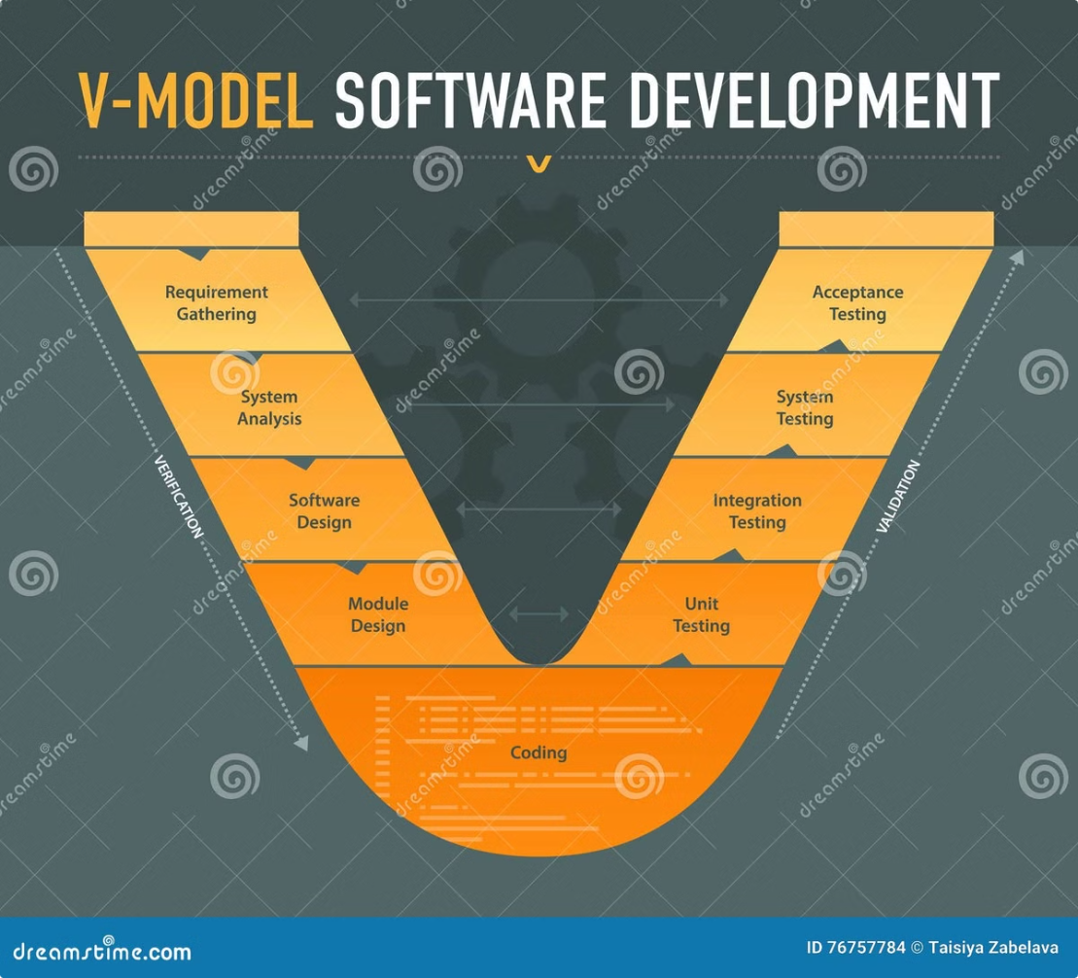

The V-Model in Software
Development
by Raghav Panthi

Slide 2
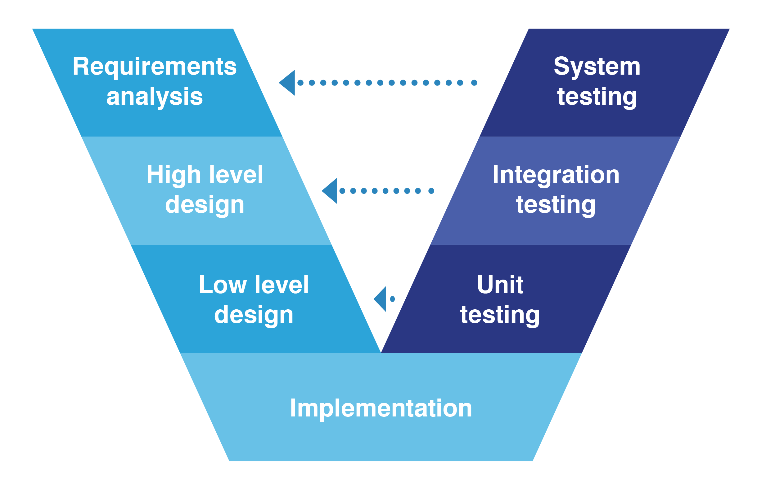
Introduction to V-Model
1
Definition
The V-Model (Verification and Validation model) in which emphasizes a structured approach where each development stage is directly linked to a corresponding testing stage.
2
Origin
Developed in response to waterfall model criticisms.
3
purpose
This model aims to provide a clear mapping between development and testing phases, ensuring that verification and validation happen at each stage.

Slide 3
Detailed Description of the V-Model Phases
Requirements Analysis
Gathering and analyzing
project requirements.
1
2
High-level design of architecture and modules.
System Design
Architectural Design
3
Detailed design for modules and
data structures.
Designing individual modules in detail.
4
Module Design
Coding
Writing code per the detailed design.
5
Parallel testing phases like
unit and integration testing.
6
Testing Phases

Slide 4





Development Phase
Requirements Analysis
Define and document all system requirements.
System Design
Create high-level design of the overall system.
Architecture Design
Develop detailed design for each system component.
Module Design
Design individual modules and units of the system.
Coding
Write a code as per system.
5

Slide 5

Testing Phase
Unit Testing
Test individual code units or modules.
Integration Testing
Verify interactions between integrated components.
System Testing
Evaluate the complete, integrated system.
Acceptance Testing
Ensure system meets specified requirements and user needs.

Slide 6
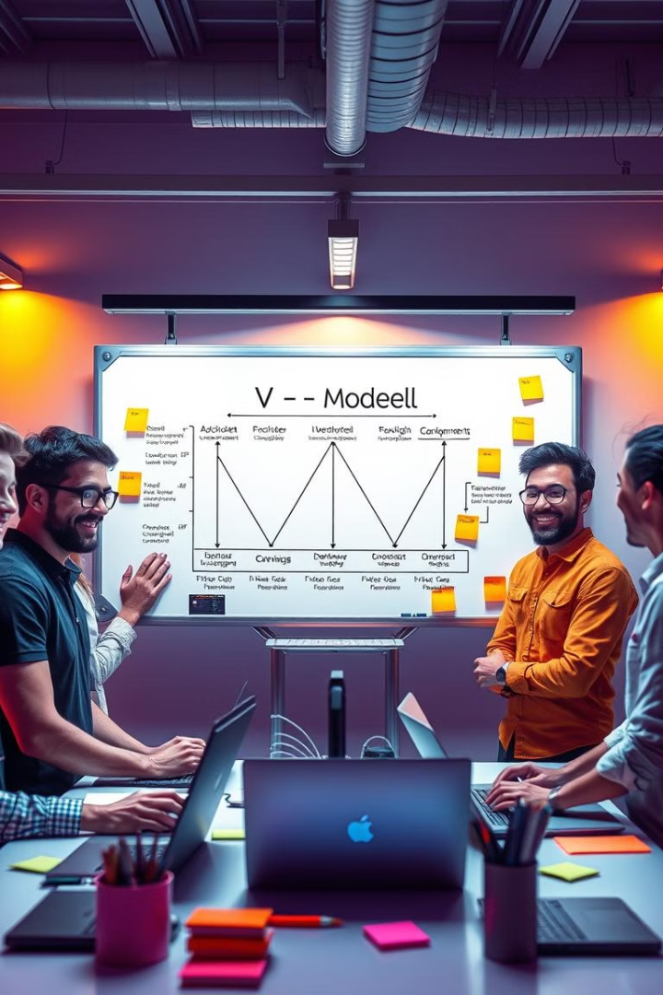




Pros of V-Model
Clear Structure
Early Test Planning
Well-defined stages with specific deliverables.
Test planning starts in requirements phase.
Proactive Defect Identification
Verification and Validation
Emphasizes both aspects throughout the process.
Catches defects early in the development cycle.

Slide 7





Cons of V-Model
Inflexibility
Time-Consuming
Difficult to accommodate changes mid-development.
Can be slower than more agile methodologies.
Early Prototype Challenges
Cost Implications
No early prototypes for user feedback.
Can be expensive if issues found late.

Slide 8

Summary and conclusion
Key Considerations
provides a structured, sequential development approach
Ideal for projects with stable requirements
Strong focus on testing
Final conclusion
While the V-Model is suitable for small and well-defined projects, it may lack the flexibility needed for projects with evolving requirements.

Slide 9
Thank you !
vidā (bye bye )

